Slide 1

Personalized Optical Character Recognition System
Submitted By : - M.C.A. (Lateral Entry ) Semester-V
Preyash KaPatel
18034211003
Guided by
Prof. Upasana M. Bhilota
Submitted to Acharya Motibhai Patel Institute of Computer Studies,
GANPAT UNIVERSITY
July-Dec 2020

Slide 2
Personalized Optical Character Recognition System
Live at preyash2047.github.io

Slide 3
Index
Content | Page No
Project Profile | 4
Definition | 5
Requirement Specification | 6
Feature of Present OCR System | 7
Problems with Present OCR System | 8
Why Personalized OCR System is needed? | 9
Client Side Specification | 10
Developer Side Specification | 11
Proposed Personalized OCR System's Work flow | 12
Function Module Specification | 13
System Flow Chart | 17
Use-Case Diagram | 19
Sequence Diagram | 21
Activity Diagram | 23
Input and Output Design | 25
Machine Learning Model | 33
Future Enhancement | 35
Bibliography | 37

Slide 4
Project Profile
Project Title | Document Management System
Project category | Web Application
Objective | To develop an application that can convert handwritten document to computerized text
Front End | Javascript, HTML, Bootstrap 4, CSS
Back End | Javascript
Tool | Python, Google Colab, Tensoreflow, Tensoreflow.js, Anaconda and Atom
Server | Github Server
Documentation Tool | Microsoft Office 365
Internal Guide | Prof. Upasana M. Bhilota
Developed By | Preyash S. KaPatel (18034211003)
Group No | 4

Slide 5
Definition
Personalized OCR System is web based application to recognize hand written text from image
Object of this web application to recognize text of handwritten notes of Ancient Scientists and Leader

Slide 6
Requirement Specification

Slide 7
Feature of Present OCR System
Preset OCR System is able to recognize the computerized text
Able to detect document and table for text angel detection
Here is the some example of Present OCR Systems:
Google Keep, Google Translator, Adobe Scan, Cam Scanner and etc.

Slide 8
Problems with Present OCR System
Reading hand written documents are tedious
Present OCR system does not much accurate in terms of handwritten document
Each of us is having different handwriting so general model is not capable to understand all character
It requires rewriting of document which employs cost to required resources like human, hardware, money and time.

Slide 9
Why Personalized OCR System is needed?
To Recognize handwritten document
01
Higher accuracy can be achieved with personalized handwritten text style
02
Finding inside the document can be improved
03
For huge data it is cost effective in terms of resources
04

Slide 10
Client Side Specification
Minimum Requirement of Hardware and Software:
Hardware Requirement:
Basic CPU with 700 MHz Speed
1 GB RAM
Software Requirement:
Chrome with 68.0.3440.75 or above Version
Good Internet Speed

Slide 11
Developer Side Specification
Minimum Requirement of Hardware and Software:
Hardware Requirement:
Inter i5 10th generation
8 GB RAM
10 GB Space in SSD
8 GB Nvidia Graphics Card
Software Requirement:
Chrome with 68.0.3440.75 or above Version
High Speed Internet
Google Colab
Webpage IDE
Github Desktop

Slide 12
Proposed Personalized OCR System's Work flow
Step 1: Perform the Standard OCR (Predefined model in OCR System)
--> Checking the accuracy if it is low go to step 2
Step 2: By giving handwritten Text image and computer written text for its learning
--> Checking the accuracy if it is still low go to step 3
Step 3: Character wise training to model (Main Business Logic of System)
User will able to store the personalized style of handwriting for further use

Slide 13
Function Module Specification

Slide 14
Function Module Specification
Model Training
Train Model
Text Detection
Model Selection
Classifiy image
Download Trained Model
Function Module

Slide 15
Model Training
Train Model:
User can train model for own handwriting style
Download Trained Model
For further use it can be downloaded

Slide 16
Text Detection
Model Selection
User can upload own model to Classify
Can use Standared Model to Classify Images
Classifiy image
It will load the model and Image to perform Classification

Slide 17
System Flow Chart

Slide 18
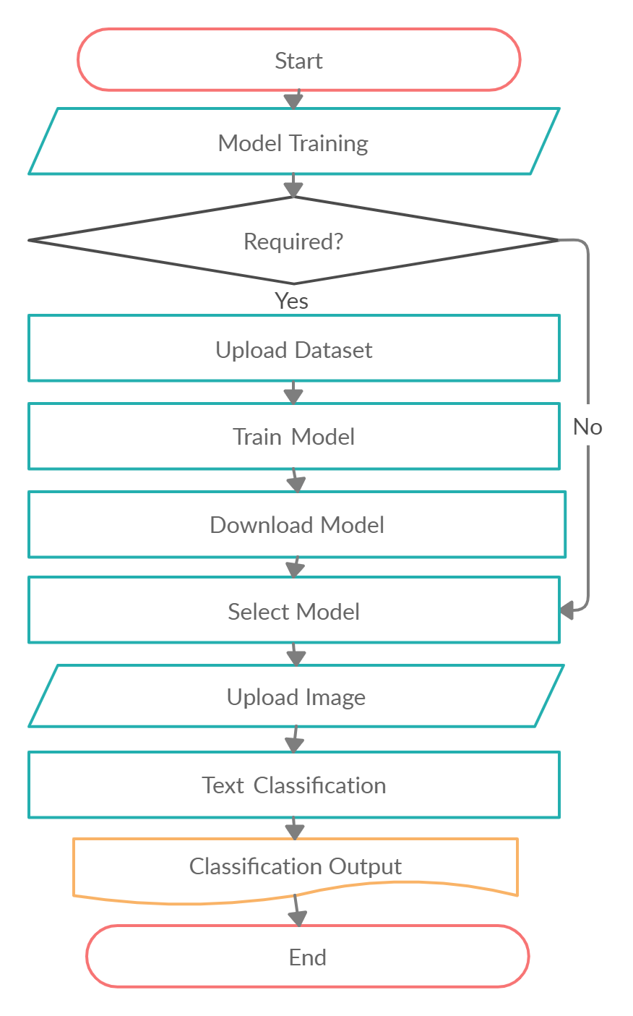
System Flow Chart
Legends:
Dataset:
Handwritten Text as per the Standared Formate
Train Model:
It will train model on the bases of Dataset
Upload Image:
Input the image for text detaction
Text Classification:
It will generate classification class
Classification Output:
It will print the class of image classification

Slide 19
Use-Case Diagram

Slide 20
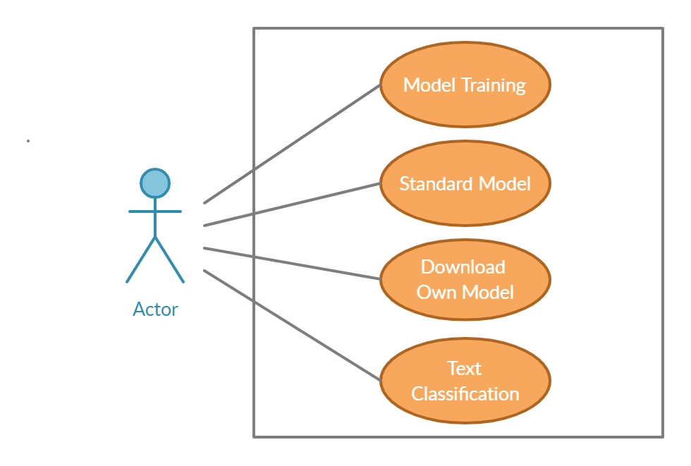
Use-Case Diagram

Slide 21
Sequence Diagram

Slide 22
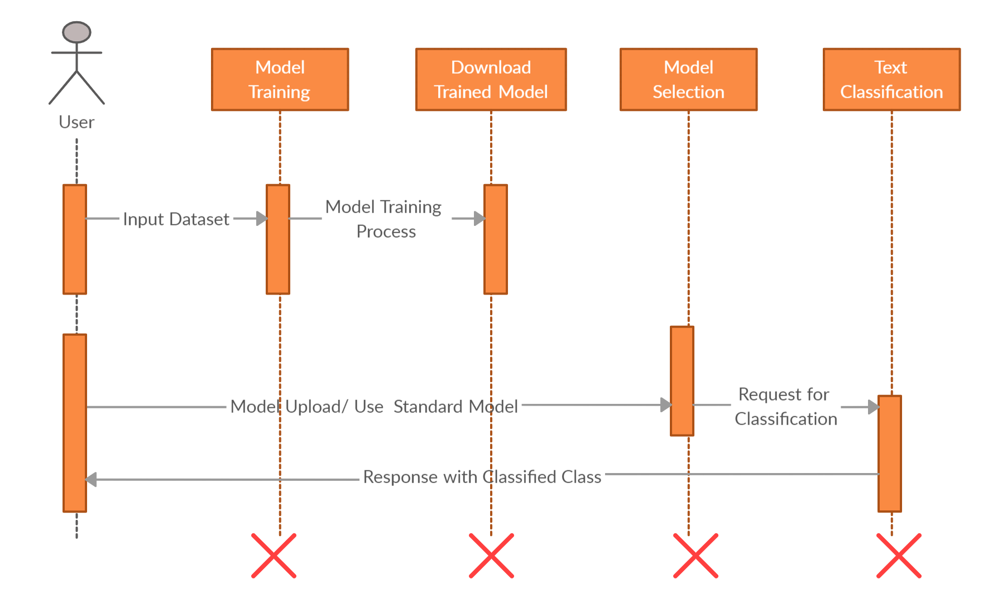
Sequence Diagram

Slide 23
Activity Diagram

Slide 24
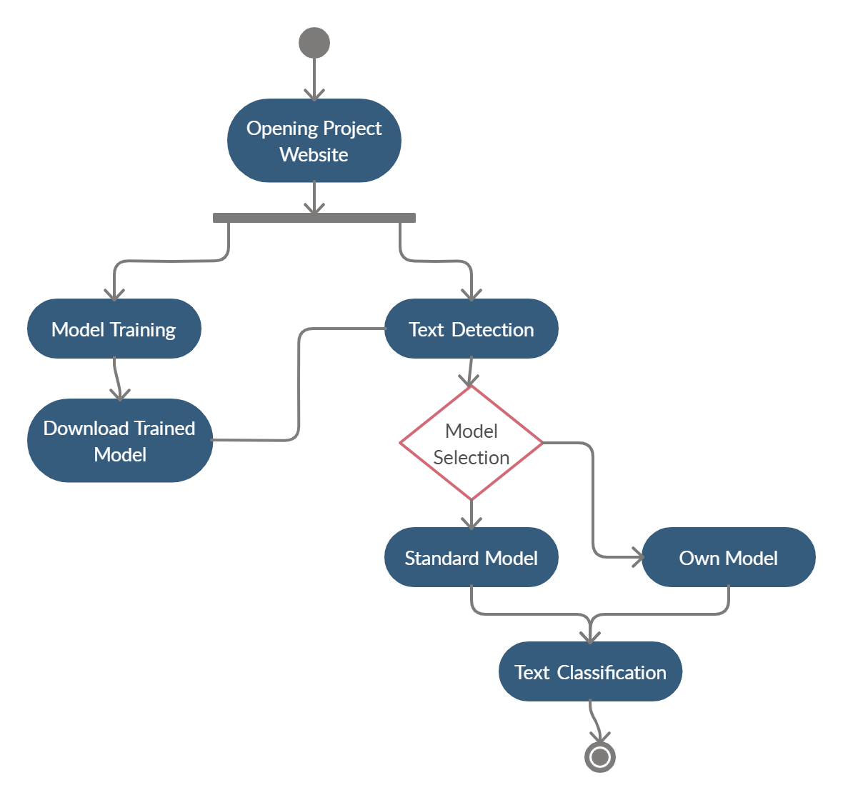
Activity Diagram

Slide 25
Input and Output Design

Slide 26
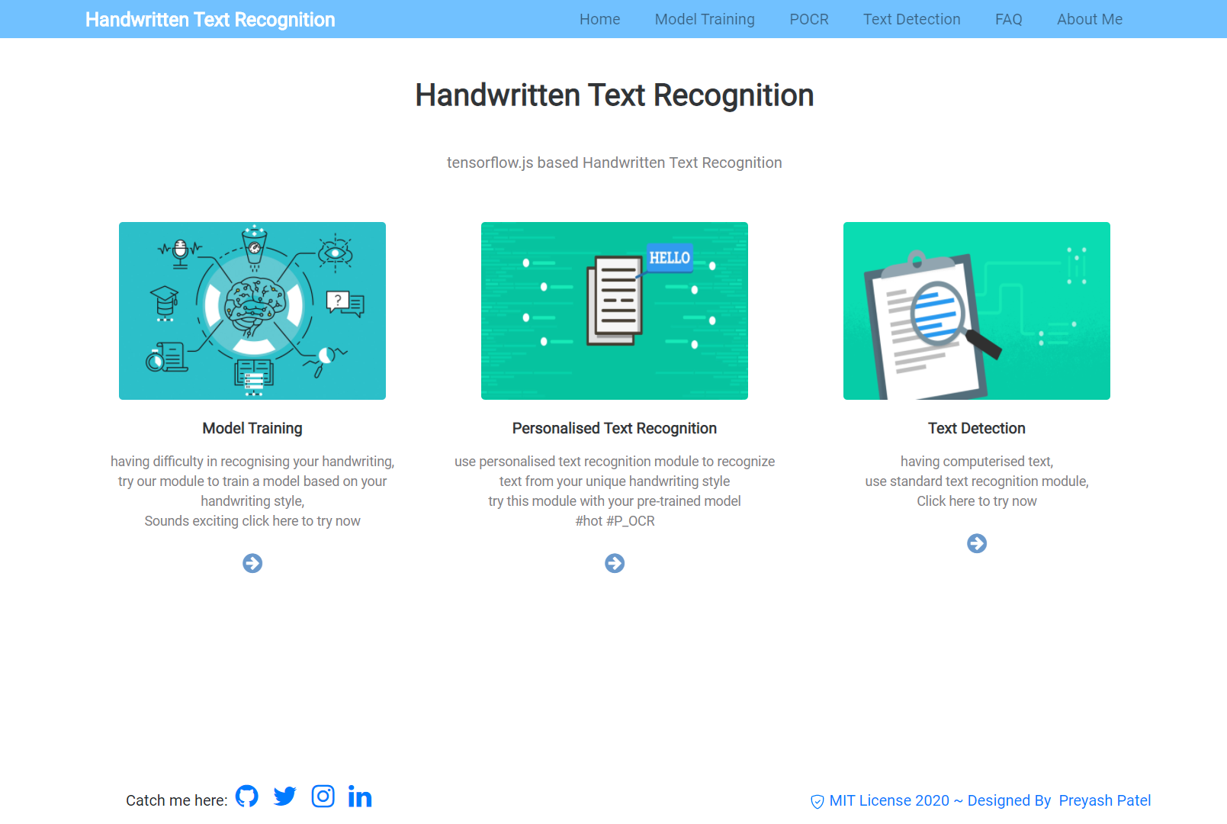
Home Page

Slide 27
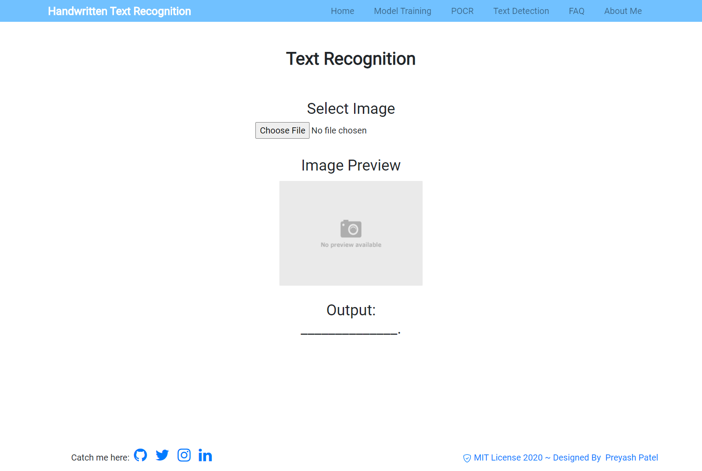
Text Recognition (Before any input)

Slide 28
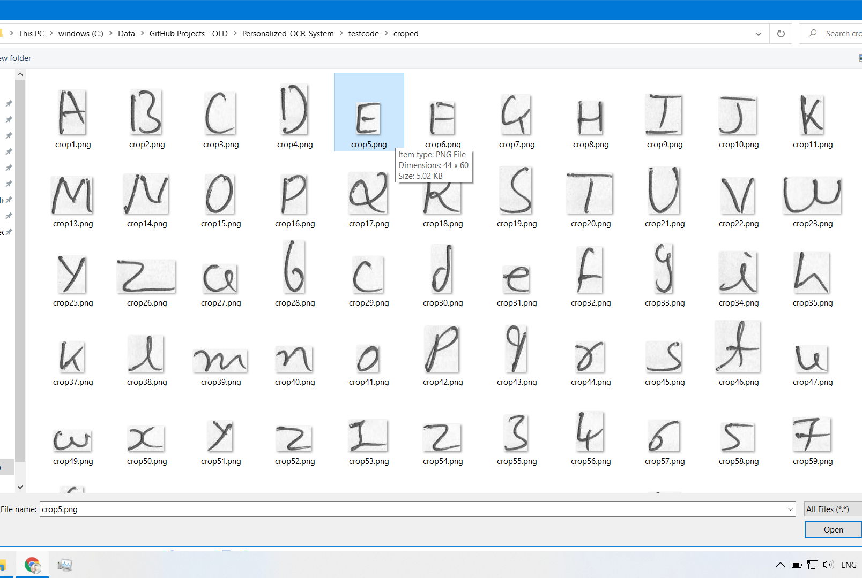
Text Recognition (Selecting input image for text recognition)

Slide 29
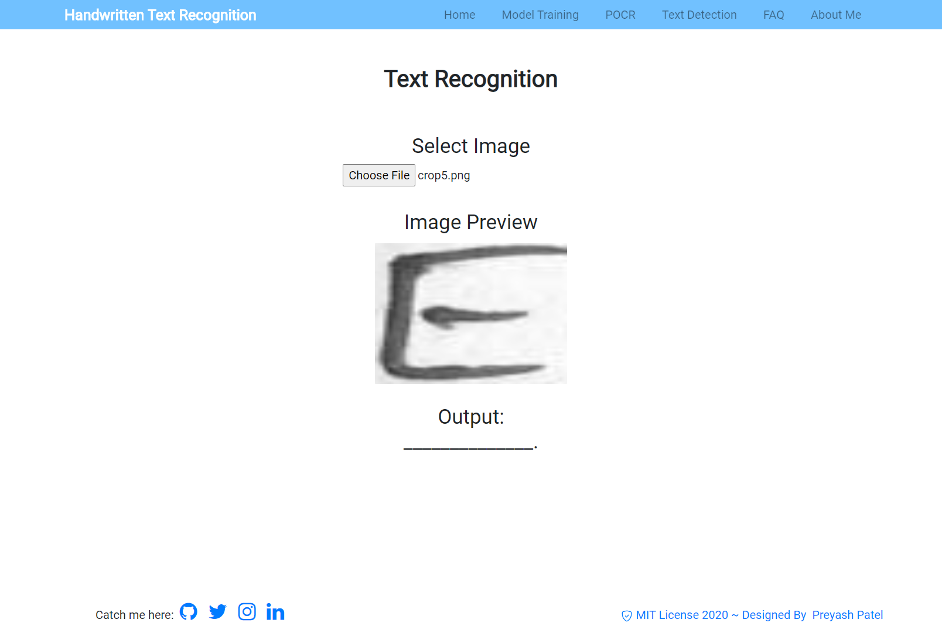
Text Recognition (input image preview)

Slide 30
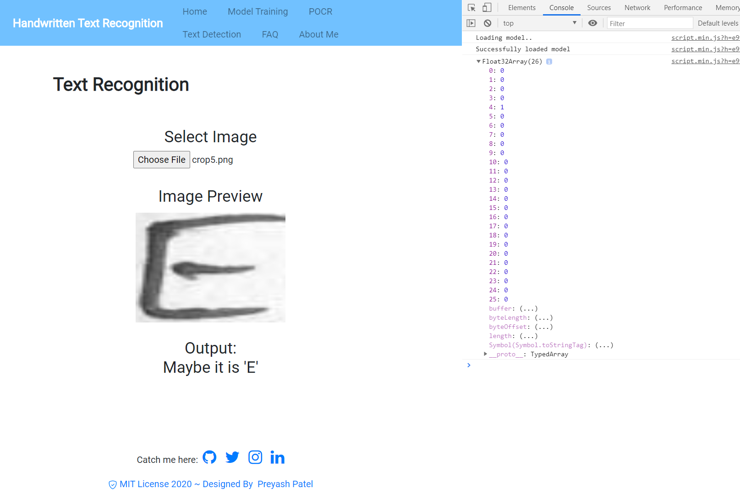
Text Recognition (Output with console log status)

Slide 31
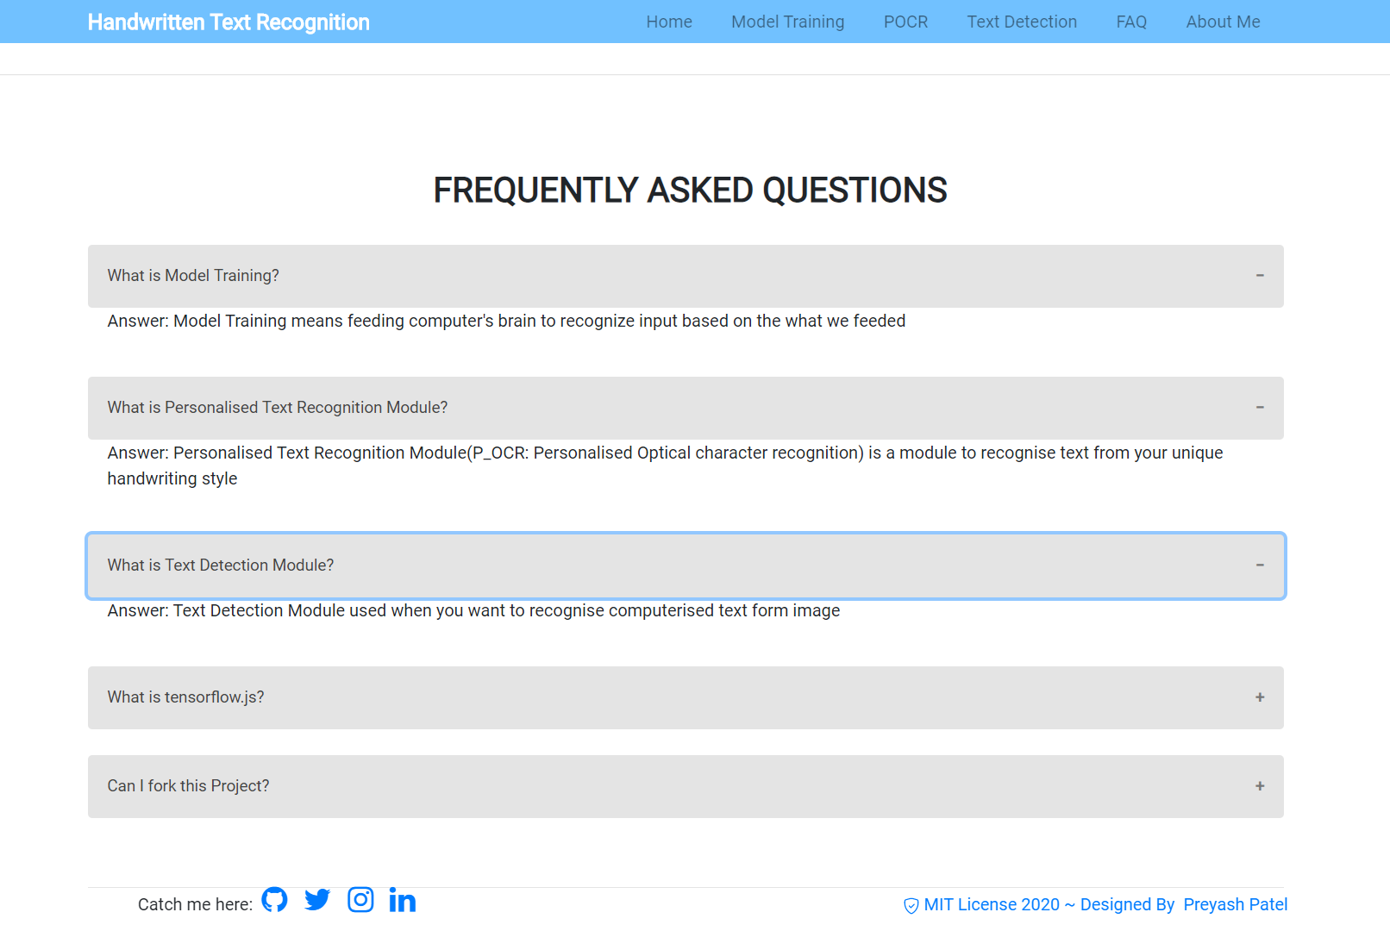
FAQ Page

Slide 32
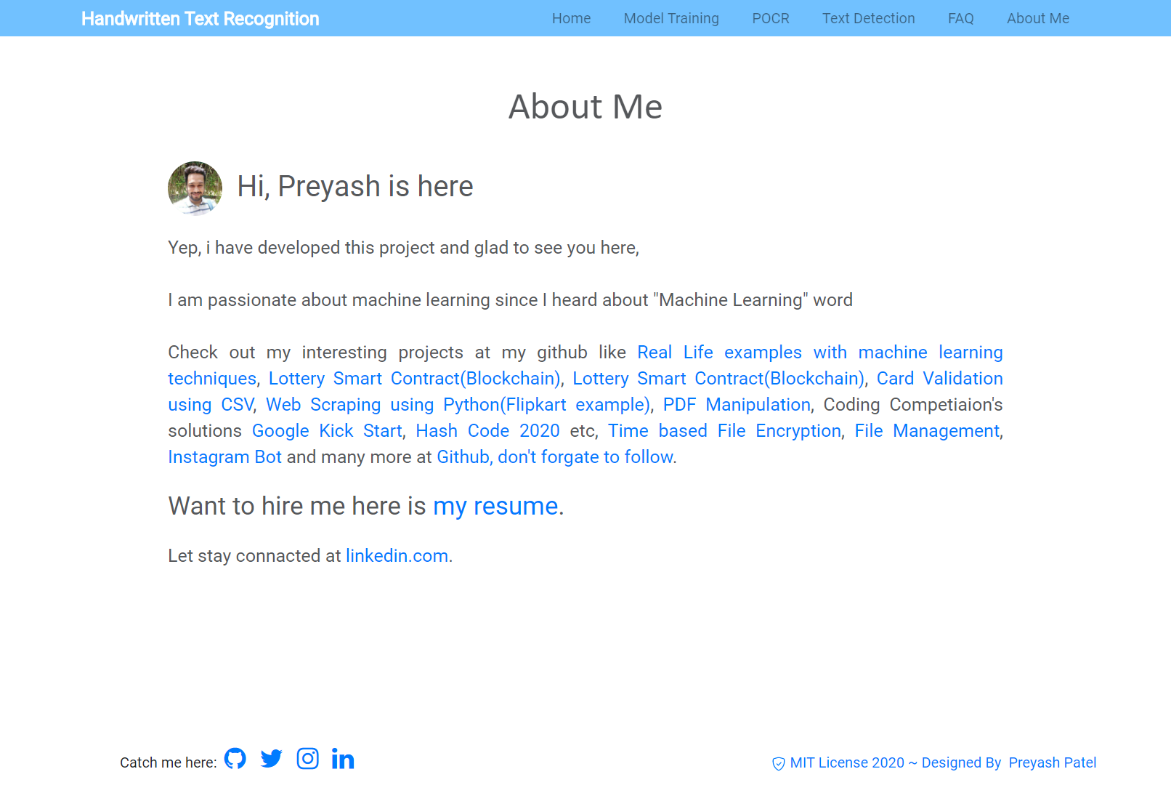
About me Page

Slide 33
Machine Learning Model
Includes accuracy of model

Slide 34
ML Model
Model is based on Keras h5 algorithm with tensorflow, it is python based model(Notebook: Selective Model)
Selective Model has given the accuracy of 80.70%
For JavaScript keras model is converted to .json model using tensorflow.js converter, this model is known as tensorflow.js model (tensorflow.js Model)
This model is implemented in live project (i.e. http://preyash2047.github.io/)
Data Preprocessing Notebooks are available at here.
Source Code of the Project available at github.

Slide 35
Future Enhancement

Slide 36
Future Enhancement
Will introduce Personalized model training for end users using tensorflow.js
Further will introduce Text Detection with document and generate output in text/word/ image format
Will introduce model with Natural Language Processing to take the accuracy at next level

Slide 37
Bibliography

Slide 38
Bibliography
This Project is built with Google colab Notebook and Bootstrap Studio
Have used the following documentation:
tensorflow.org/js
tensorflow.org
Keras.io
opencv.org
getbootstrap.com
Help taken form the Following community:
stackoverflow.com
github.com

Slide 39

Thank You

